Slide 1
ITSA線上程式競賽基礎題目
#1~5

Slide 2
題目1. 矩陣數字顯示
https://e-tutor.itsa.org.tw/e-Tutor/mod/programming/view.php?id=30746
運算思維: (課堂講解)
程式碼說明: (課堂講解)

Slide 3
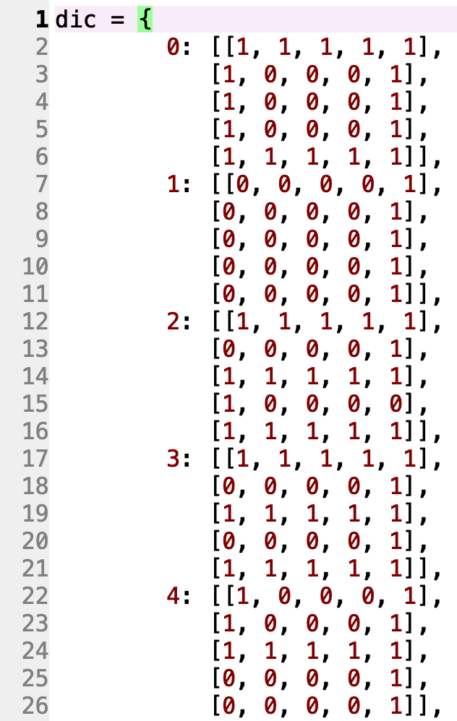
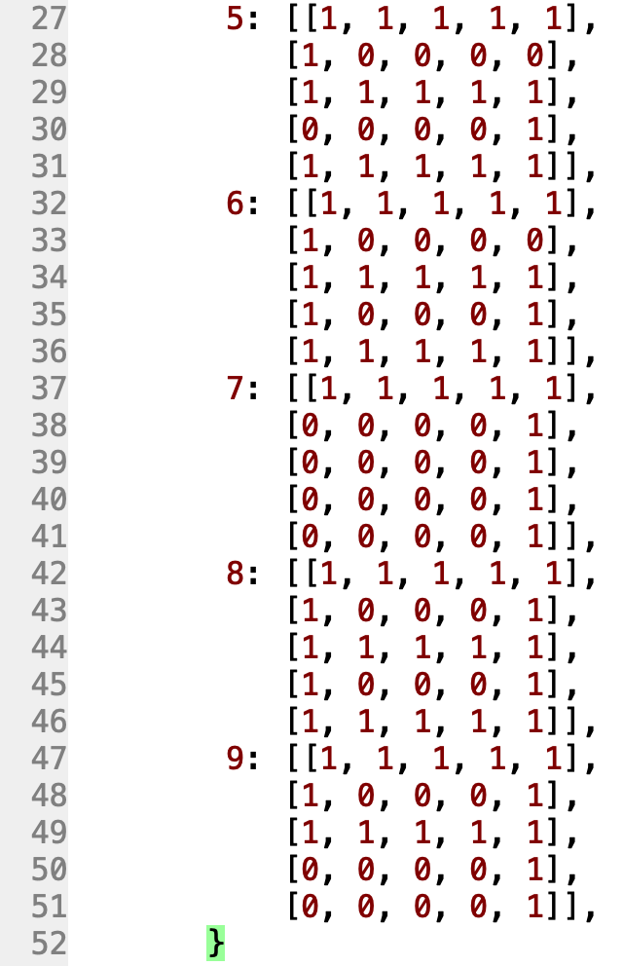
﻿1234
* ***** ***** * *
* * * * *
* ***** ***** *****
* * * *
* ***** ***** *
5678
***** ***** ***** *****
* * * * *
***** ***** * *****
* * * * * *
***** ***** * *****
9012
***** ***** * *****
* * * * * *
***** * * * *****
* * * * *
* ***** * *****

Slide 4
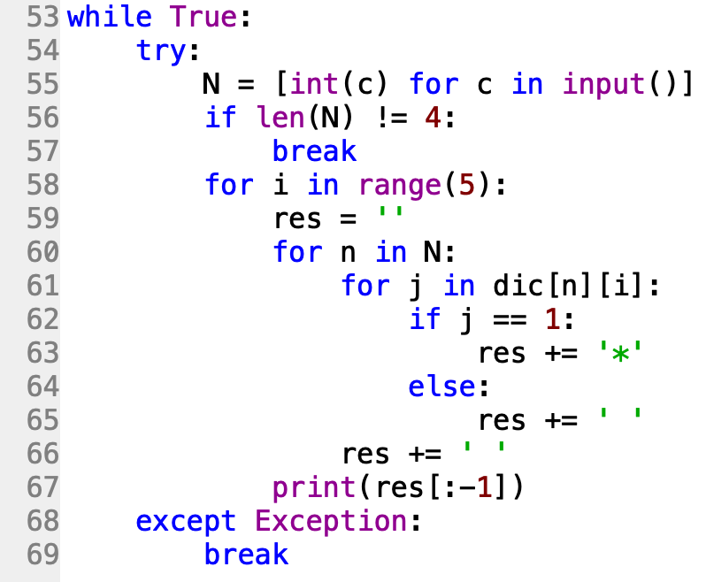

Slide 5
題目2. 英哩轉公里
https://e-tutor.itsa.org.tw/e-Tutor/mod/programming/view.php?id=30747
運算思維: (課堂講解)
程式碼說明: (課堂講解)

Slide 6
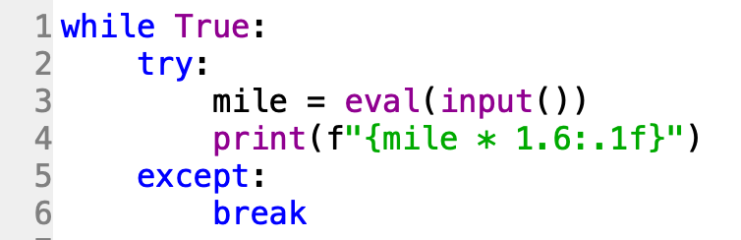

Slide 7
題目3. 判斷座標是否在圓形的範圍內
https://e-tutor.itsa.org.tw/e-Tutor/mod/programming/view.php?id=30749
運算思維: (課堂講解)
程式碼說明: (課堂講解)

Slide 8
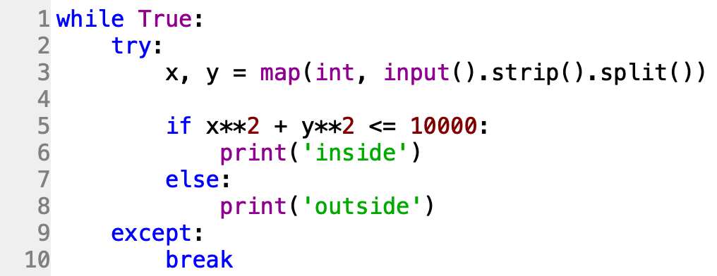

Slide 9
題目4. 停車費計算
https://e-tutor.itsa.org.tw/e-Tutor/mod/programming/view.php?id=30748
運算思維: (課堂講解)
程式碼說明: (課堂講解)

Slide 10
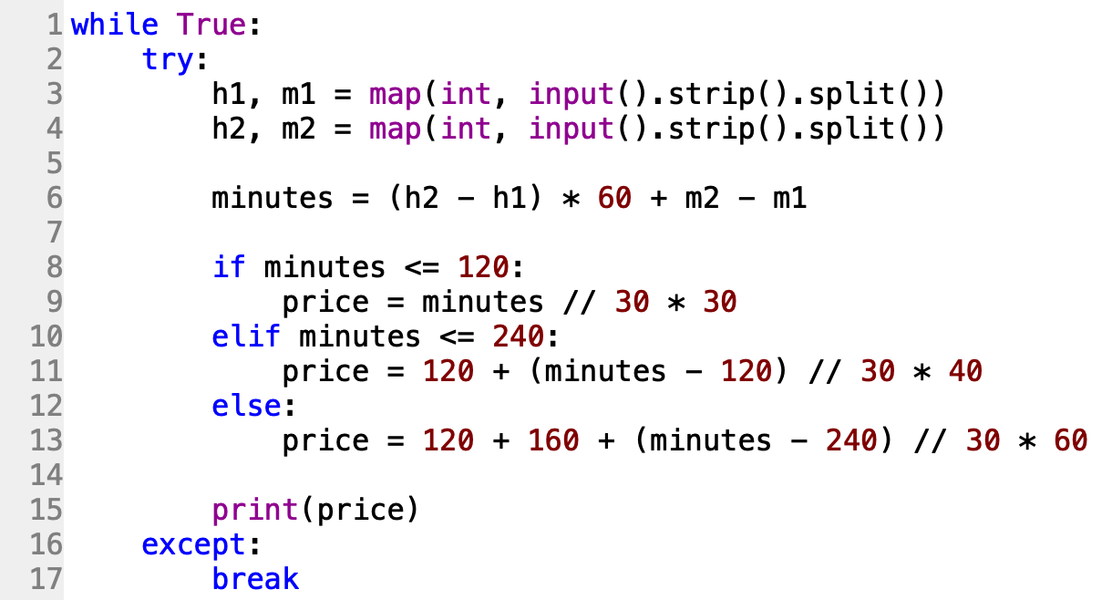

Slide 11
題目5. 十進制轉二進制
https://e-tutor.itsa.org.tw/e-Tutor/mod/programming/view.php?id=30750
運算思維: (課堂講解)
程式碼說明: (課堂講解)

Slide 12
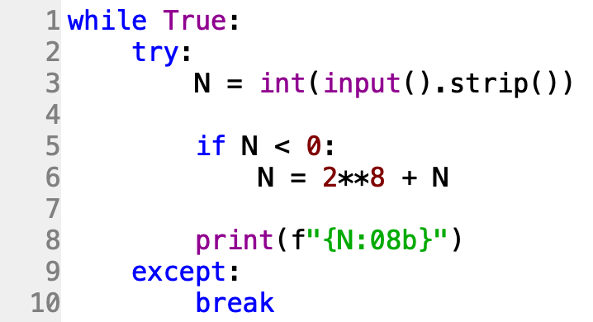
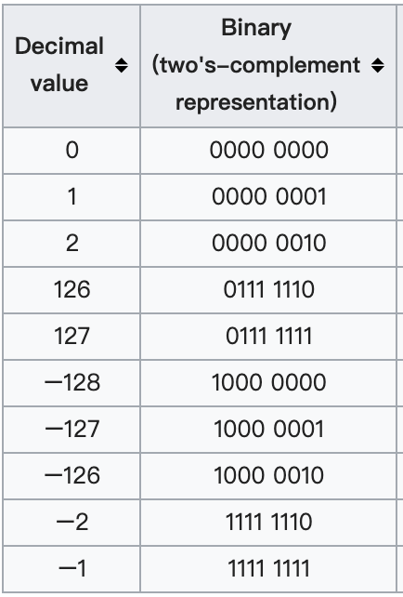
Preliminary Concepts: Negative Binary Numbers
https://www.calvin.edu/academic/rit/webBook/chapter5/negative.htm Two's complement
https://en.wikipedia.org/wiki/Two%27s_complement

